Slide 1
夥伴商店發展專題
Partner Stores Development
Marcus Chan
商業夥伴拓展經理
Affiliate Development Manager
本簡報中提到的收入等級純屬舉例說明，無意代表美安香港超連鎖™店主的一般收入，也無意表示任何超連鎖™店主皆可賺取同等收入。美安香港超連鎖™店主的成功與否，取決於其在發展事業時的努力、才能與投入程度。The income levels mentioned in the following presentation are for illustration purposes only. They are not intended to represent the income of a typical Market Hong Kong UnFranchise ™Owner, nor are they intended to represent that any given Independent UnFranchise ™ Owner will earn income in that amount. The success of any Market Hong Kong Independent UnFranchise ™ Owner will depend upon the amount of hard work, talent, and dedication which he or she devotes to building his or her Market Hong Kong Business.

Slide 2
HK.SHOP.COM
Partner Store

Slide 3
Average Online Shopping amount is $15250
98% of
Respondents satisfy online shopping

Slide 4
4X

Slide 5
HK.SHOP.COM x Partner Store
Market Hong Kong
Preferred Customer
Partner Store
UFO

Slide 6
HK.SHOP.COM x Partner Store
SHOP.COM awarded cashback to Preferred Customer
Preferred Customer
HK$ 211,430,104

Slide 7
HK.SHOP.COM x Partner Store
30%
UFO
UFOs qualified
For SABP
*Compared with Jan-Jun in 2015 and 2016

Slide 8
HK.SHOP.COM x Partner Store
82%
Partner Store
Sales Revenue
*Compared with Jan-Sep in 2015 and 2016

Slide 9
HK.SHOP.COM x Partner Store
83%
MarketHongKong
Traffic of
hk.shop.com
*Compared with Jan-Sep in 2015 and 2016

Slide 10
Q
Jan-aug 2016
HK.SHOP.COM
Partner Stores Joined

Slide 11
<5% IBV, 2% Cashback>
[Online Shop]

Slide 12
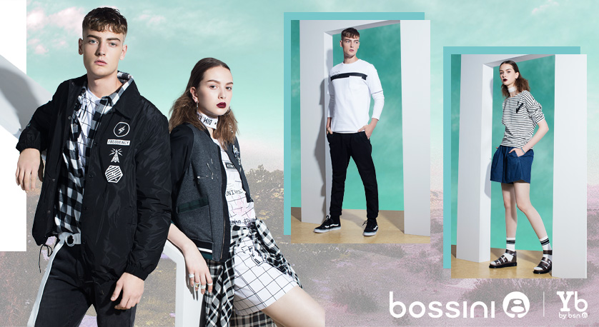
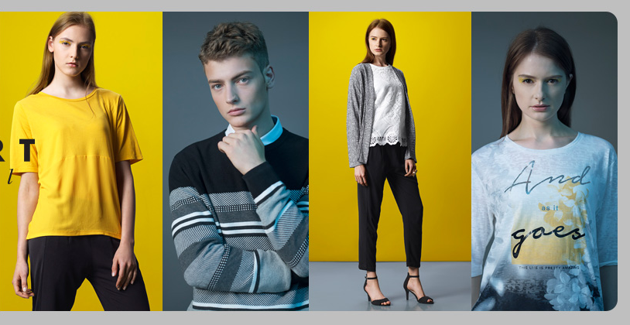
<4% IBV, 3% Cashback>
[Online Shop]

Slide 13
<5% IBV, 5% Cashback>
[Walk-in & Online Shop]

Slide 14
<5% IBV, 2% Cashback>
[Online Shop]

Slide 15
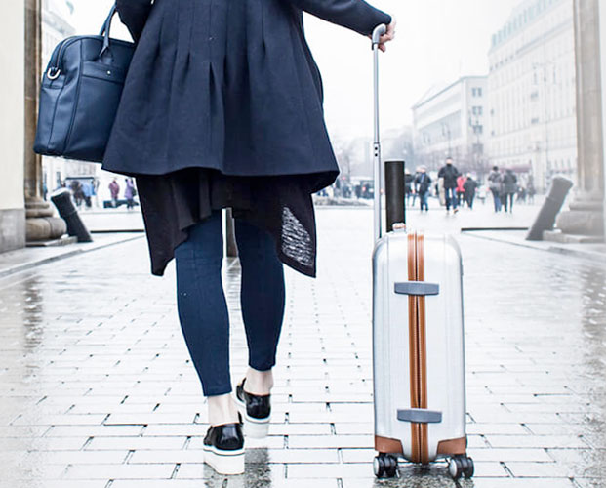
<5% IBV, 2% Cashback>
[Online Shop]

Slide 16
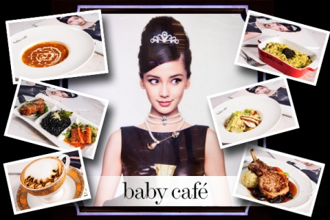
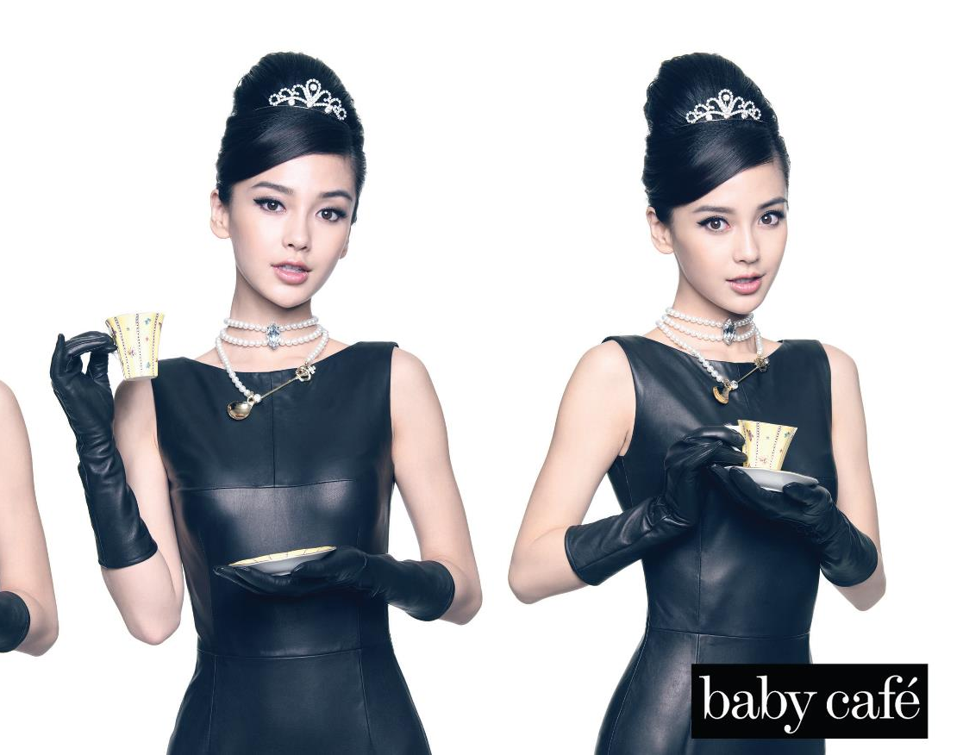
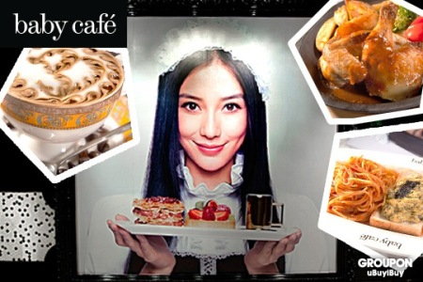
<5% IBV, 2% Cashback>
[Walk-in Shop]

Slide 17
<4% IBV, 2% Cashback>
[Walk-in & Online Shop]

Slide 18
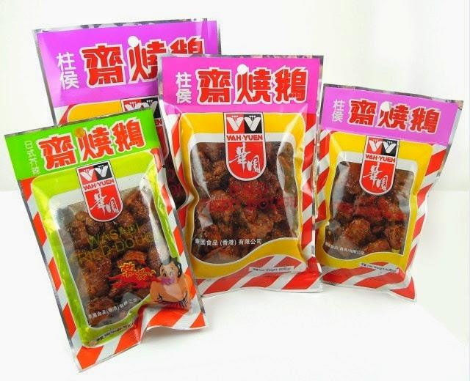
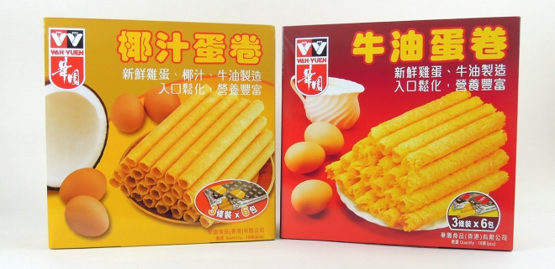
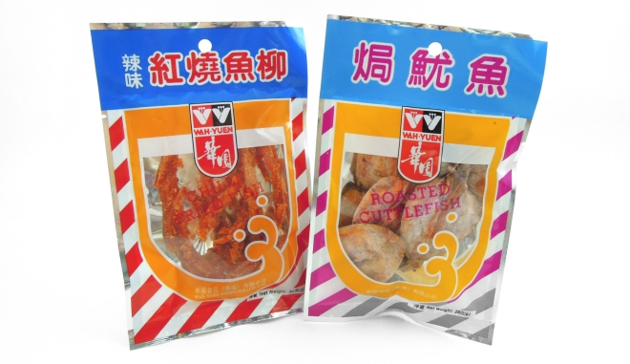
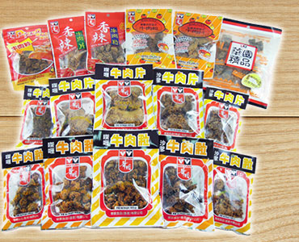
<4% IBV, 4% Cashback>
[Online Shop]

Slide 19
<4% IBV, 2% Cashback>
[Online Shop]

Slide 20
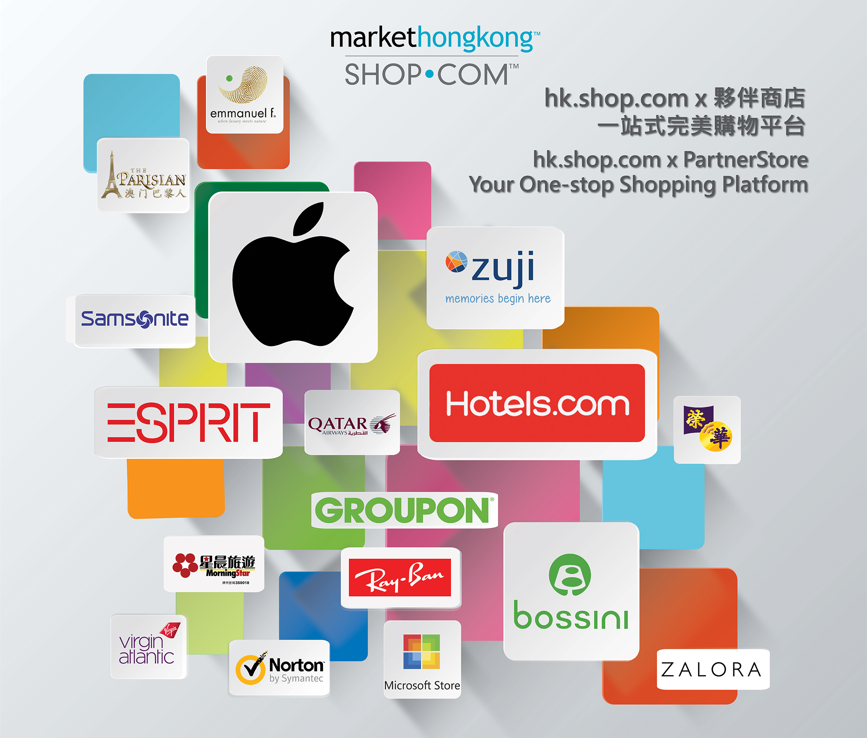

Slide 21
Partner Store New Offer

Slide 22
11.11 Campaign is launched - Double Cashback & Double IBV

Slide 23
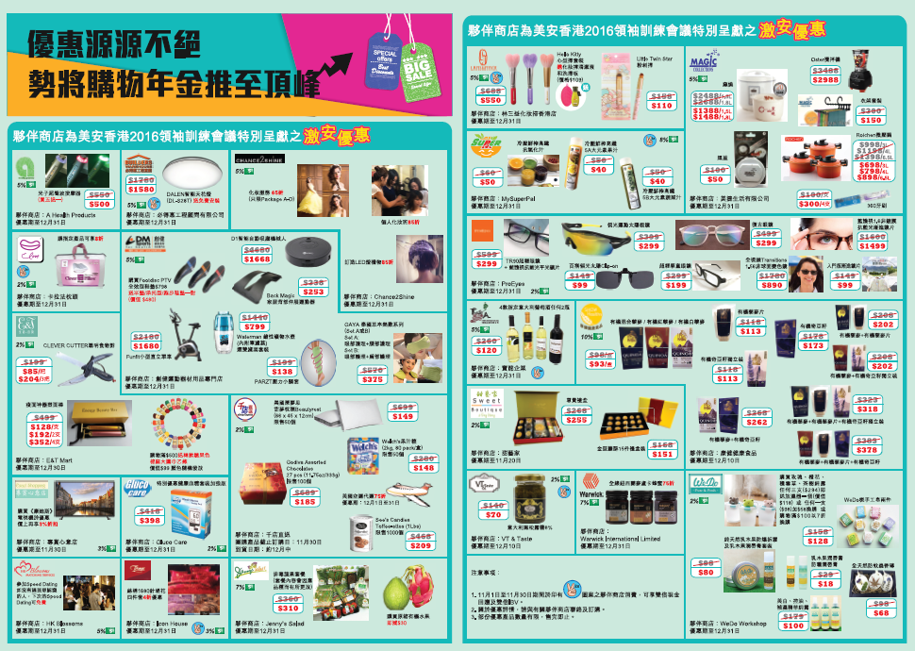

Slide 24
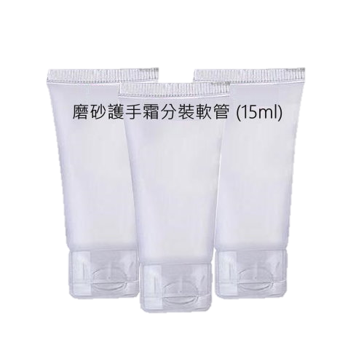
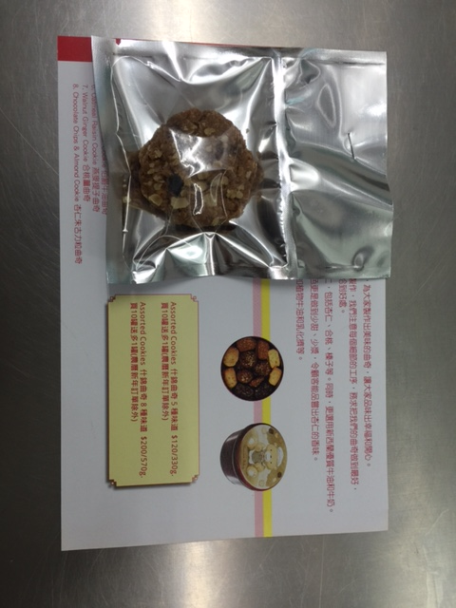
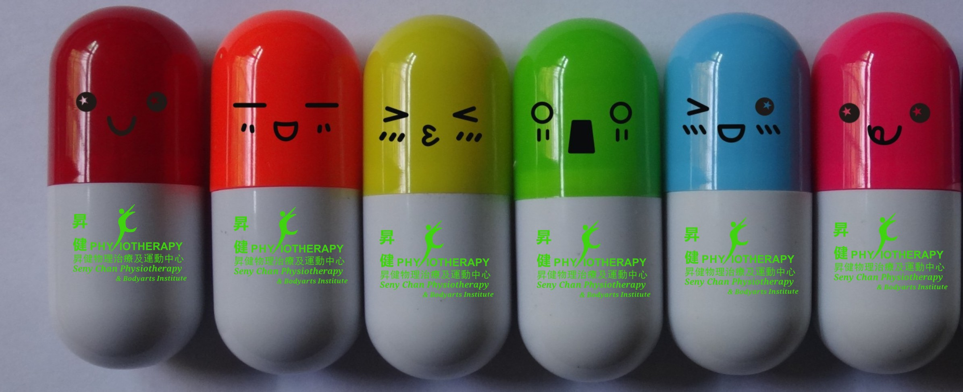
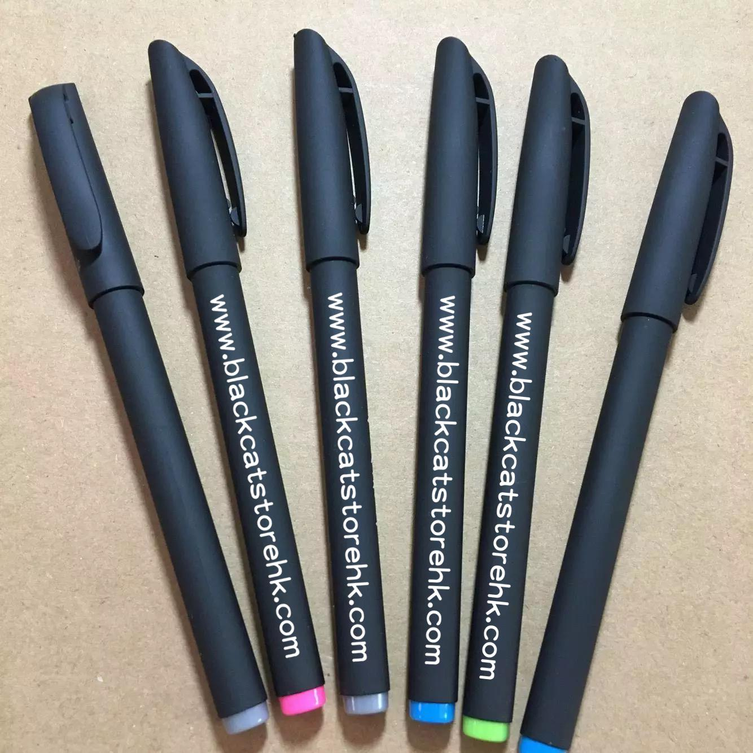
Special thanks to the following Partner Store for welcome gifts sponsors
*offer is available until stocks last

Slide 25
Facebook Fan page of hk.shop.com is launched, with updating hot deals, trend and shopping tips

Slide 26
hk.shop.com PartnerStore Fanpage
reached over 20,000 in first month after launched

Slide 27
🎁Gift Away🎁
1. ‘Like’👍 our Fanpage
2. Message and share a photo of purchasing in HK.SHOP.COM Partner Store 📷
3. Write a happy shopping experience！
The best 10 participants we have chosen will receive a mystery gifts🎁
Promotion Start date: 11 Nov
Promotion End date : 10 Dec 23:59

Slide 28
Voting Campaign for
My favorite Partner Store

Slide 29
Top 3 of My favorite Partner Store

Slide 30
Jan-aug 2016
THE HIGHEST SALES Partner Store

Slide 32
What are the popular brands of
Partner Store which will be joining?

Slide 33
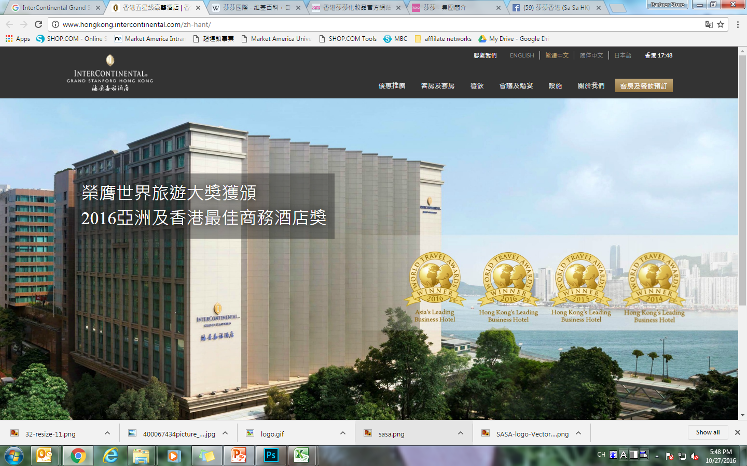
[Online Shop]
One of the famous luxury five-star hotels in Hong Kong, and one of the members of Intercontinental Hotel
Offers sophistication and heritage amidst the breath-taking view of Victoria Harbour. The luxuriously appointed guest rooms and suites, the excellent meeting and event facilities in a comfortable setting as well as a host of world-class restaurants make it the perfect choice for business and leisure travellers alike.
Notes:
是香港著名的豪華五星級酒店之一，是洲際酒店成員之一
坐擁壯麗迷人的維多利亞港景致及璀燦的香港美景，鄰近購物商場、娛樂及商業中心
酒店設有豪華的客房及套房並備有先進的科技設施及世界級的佳餚美食，為商務及消閒旅客帶來最貼心的優越服務

Slide 34
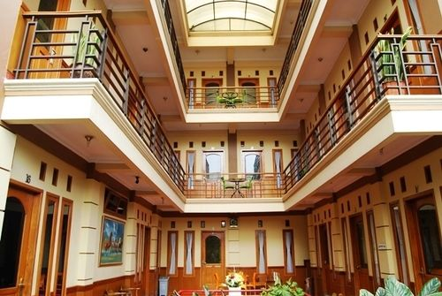
[Online Shop]
ZUZU hotel in Taiwan and Indonesia has covered 20 cities
offers an economical and comfort room
ZUZU awards : Stay 10 nights get 1 free night

Slide 35
[Online Shop]
Offering a diverse range of products with over 26,000 products
Includes skin care, beauty, body slimming, personal care, maternal and child care and etc.

Slide 36
日本樂天市場
[Online Shop]
Japan's No. 1 Internet shopping mall
Japan's No. 1 Internet and Japan's popular online shopping site, including popular women's and men's accessories, group-buy food, brand-name products and electronic products

Slide 37
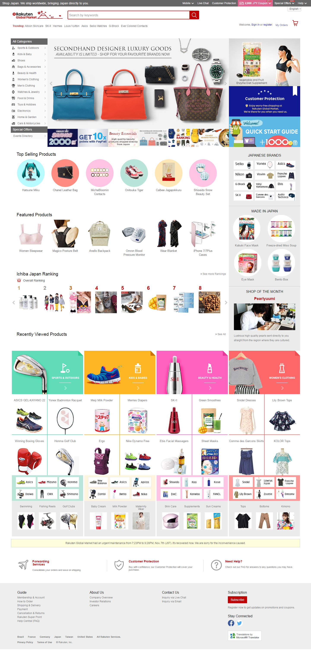

Slide 38
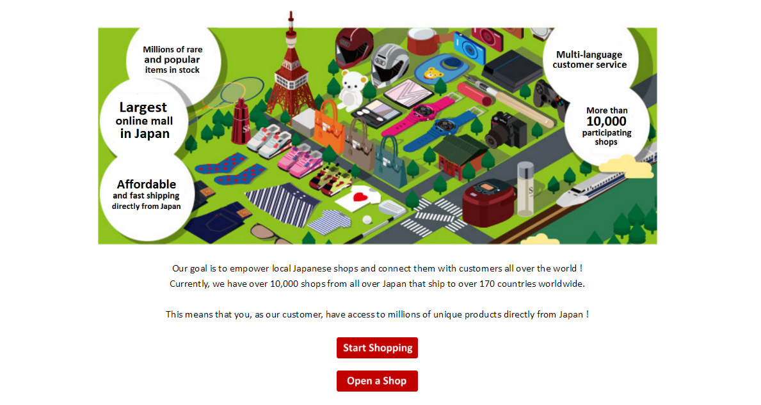

Slide 39
1. Just continue what you normally do every day
2. Earn Cashback
3. Accumulate BV & IBV
4. Achieve SABP
5. Convert Spending into Earning
Remember, Shopping is happy

Slide 40
Partner Store Lucky Draw
Will be held after lunch at 2:30pm

